Slide 1

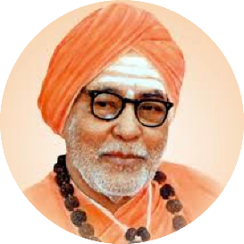


An ISO 21001:2018 certified institution | S. S. Education Trust’s CET Code: E-175 (UG)/T-942 (PG) S. G. BALEKUNDRI INSTITUTE OF TECHNOLOGY Shivabasavanagar, Belagavi- 590 010, Karnataka- India • Approved by AICTE New Delhi • Recognised by Govt. of Karnataka • Affiliated to V T U, Belagavi
 | Department of Electronics & Communication Engineering Email: hod-ec@sgbit.edu.in, Dept. Extn.: 520 | Accredited by NBA, New Delhi
First Phase Project Presentation
On
“LoRa-Based Envi-Rover"
Group No. 07 | Name of the Student | University Seat Number
 | Harish B Patil | 2BU22EC035
 | Murali V Vhanmani | 2BU22EC052
 | Narendra R Giriyappanavar | 2BU22EC054
 | Netravati M Murari | 2BU22EC056
 | Under the Guidance of MR. KIRAN S.NANDI Assistant Professor, Dept. of E&CE S. G. Balekundri Institute of Technology, Belagavi-10
19/09/2025
1

Slide 2

Contents
Introduction
Literature Survey
Problem Statement
Objectives
Proposed Methodology
Advantages and Disadvantages
Applications
References
19/09/2025
LoRa-Based Envi-Rover
2

Slide 3
Introduction
This project presents the development of Envi-Rover — a long-range, remotely controlled robotic system built using ESP-32 and LoRa technology. It is equipped with various sensors to monitor environmental parameters and detect obstacles such as rocks, debris, uneven terrain. It is designed to serve as a reliable solution for applications in Agriculture, Disaster-zones, an Industrial-environments where wireless connectivity and remote control are critical.
19/09/2025
LoRa-Based Envi-Rover
3

Slide 4
Literature Survey
S.No | Authors | Title of Paper | Methodology | Limitations
01 | J. Smith, L. Wang, A. Brown | LoRa Technology for Efficient IoT Communication in Environmental Monitoring Applications | Tested LoRa modules across terrains to measure range and power use. | Reduced range in crowded areas.
02 | M. Davis, T. Patel, S. Lee | Applications of Arduino in Educational and Industrial Robotics | Developed Arduino-based robots to test sensor compatibility in educational /industrial use. | Can’t handle complex tasks without extra hardware.
03 | R.Thompson, K. Huang, D. Gomez | Precision Agriculture: Monitoring Soil and Environmental Conditions Using IoT Sensors | Used sensors for soil and climate data, transmitted wirelessly for crop analysis. | Battery and sensor accuracy drop in harsh conditions.
19/09/2025
LoRa-Based Envi-Rover
4

Slide 5
Literature Survey
S.No | Authors | Title of Paper | Methodology | Limitations
04 | A Kumar, Y. Chen, M. Rodriguez | Obstacle Detection and Avoidance Techniques for Autonomous Robots. | Developed a robot with ultrasonic /infrared sensors for obstacle avoidance. | less accurate at high speeds.
05 | N. Evans, H. Li, F. Garcia | Robotic Platforms for Environmental Monitoring and Pollution Detection | Multi-sensor robots measured gas, temperature, and light in urban/ industrial settings. | Extreme weather like too hot or too cold affect sensor readings.
06 | P. Silva, C. Martin, V. Anand | Long-Range Communication in Agricultural Robots Using LoRa Technology | Deployed LoRa-equipped robots in fields to measure soil/air quality and latency. | Data delays in crowded areas.
19/09/2025
LoRa-Based Envi-Rover
5

Slide 6
Problem Statement
Hazardous environments pose significant risks to human health and safety, so a reliable and cost-effective solution is needed to monitor such conditions without physical human presence.
19/09/2025
LoRa-Based Envi-Rover
6

Slide 7
Objectives
Develop a LoRa-based robot for hazardous and various environment parameters monitoring.
Provide real-time data collection to improve decision-making in agriculture, disaster response, and environmental conservation.
Maximize data reliability and operational range to enhance effectiveness in industrial and agricultural contexts.
19/09/2025
LoRa-Based Envi-Rover
7

Slide 8
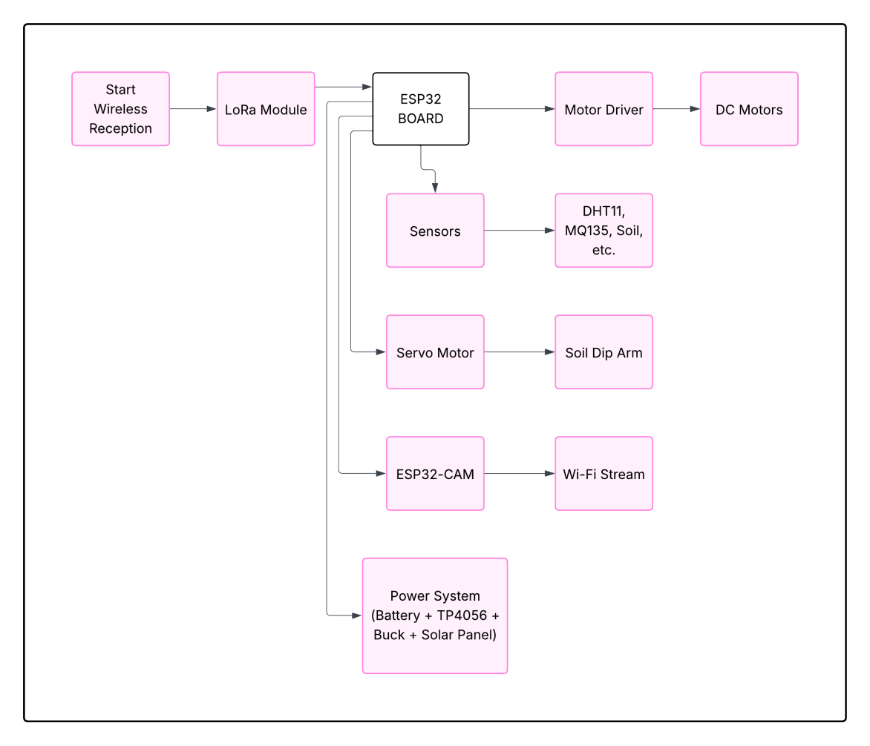
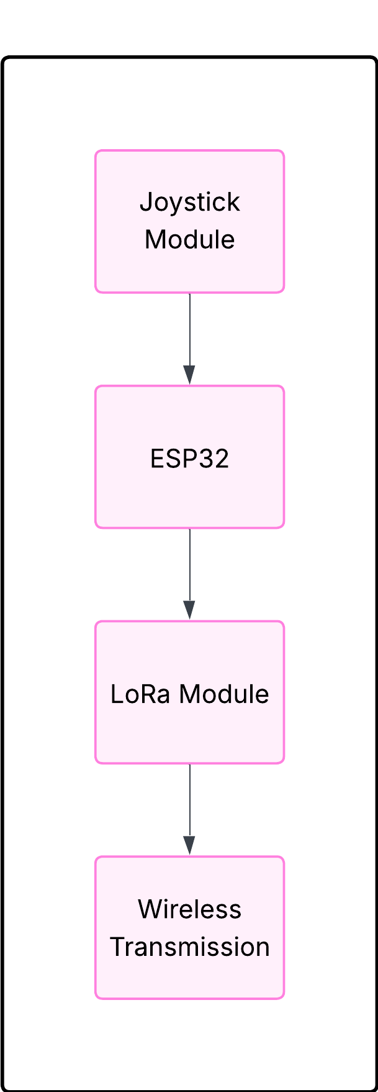
Proposed Methodology
Receiver Side
Controller Side
19/09/2025
LoRa-Based Envi-Rover
8

Slide 9
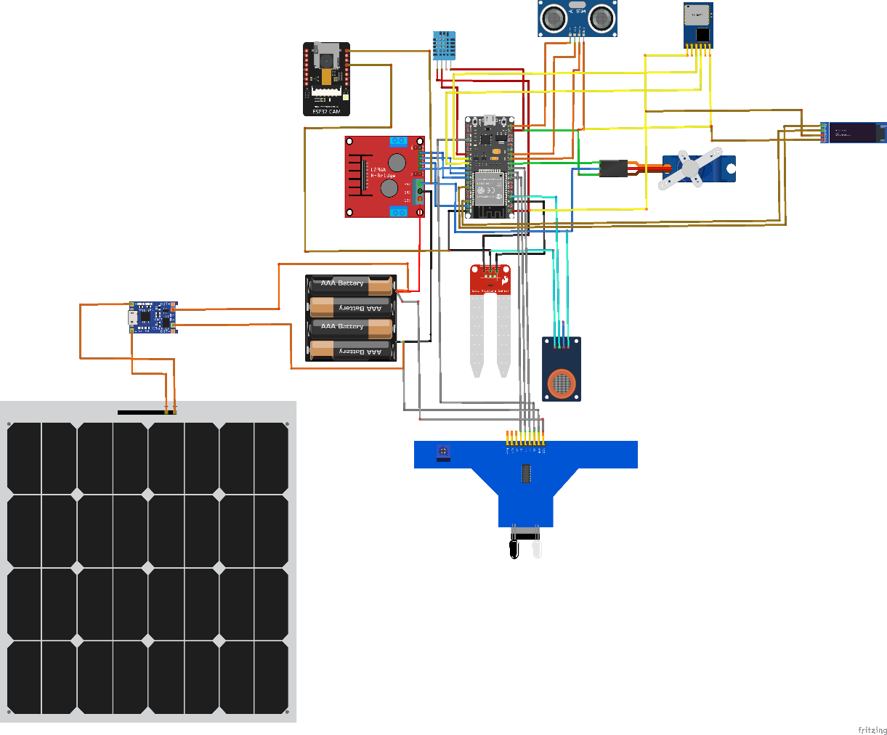
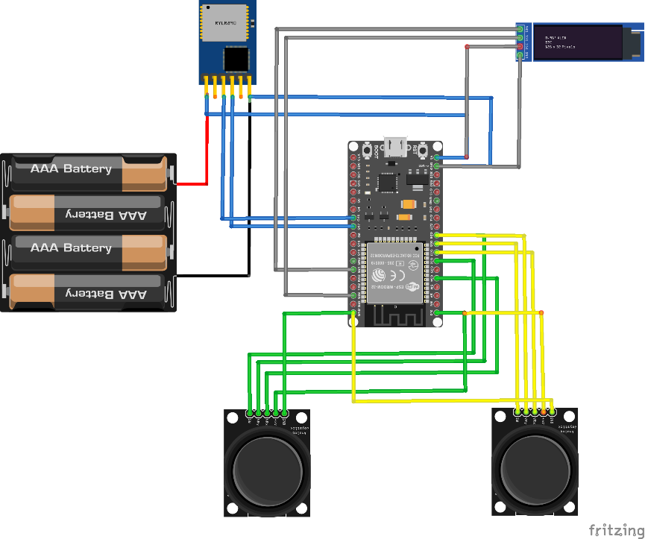
Circuit layout
Receiver circuit
controller circuit
19/09/2025
LoRa-Based Envi-Rover
9

Slide 10
Advantages
Long-Range Operation
Low Power Consumption
Real-Time Data
Cost-Effective
Remote Accessibility
19/09/2025
LoRa-Based Envi-Rover
10

Slide 11
Applications
Agriculture
Disaster Management
Industrial Environments
Scientific Research
Smart Cities
19/09/2025
LoRa-Based Envi-Rover
11

Slide 12
References
S.N | References :-
1 | LoRa Technology Overview https://lora-alliance.org/about-lorawan/
2 | ESP32 for Robotics https://docs.espressif.com/projects/esp-idf/en/latest/esp32/get-started/
3 | IoT in Agriculture https://www.cropin.com/iot-in-agriculture
4 | Environmental Sensors https://www.sunbirddcim.com/glossary/environmental-sensors
19/09/2025
LoRa-Based Envi-Rover
12

Slide 13
Conclusion
"The LoRa-Based Envi-Rover offers a cost-effective, long-range, and energy-efficient solution for remote environmental monitoring and obstacle detection. Using LoRa with ESP32 and sensors, it enables reliable data collection in hazardous or remote areas without human presence. With future upgrades like AI analytics, solar power, and improved mobility, it can support smart cities, disaster management, and environmental conservation."
19/09/2025
LoRa-Based Envi-Rover
13

